Slide 1

Working with
Angular

Slide 2



Angular Core
www.cognixia.com

Slide 3
Prerequisites
Have some exposure to JavaScript and Web development
Know the basics of HTML and CSS
Have Node.js installed on your machine: https://nodejs.org/en/

Slide 4

Why Angular?
What is Angular
Version numbers and release schedule
How is different from PHP, ASP and JSP

Slide 5
What is Angular?
Open-source web application framework, maintained by Google and the community – http://angular.io
Decouple DOM manipulation from application logic
Decouple the client-side of an application from the server side
Provide structure for the journey of building an application

Slide 6

Angular Roadmap

Slide 7
Angular Versioning and Release Schedule
ANGULAR JS = ANGULAR 1.x Versions
ANGULAR = ANGULAR 2+ Versions

Slide 8
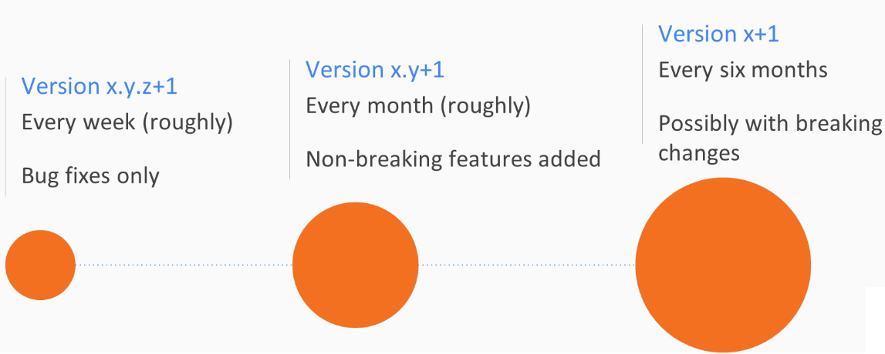
Angular Versioning and Release Schedule

Slide 9
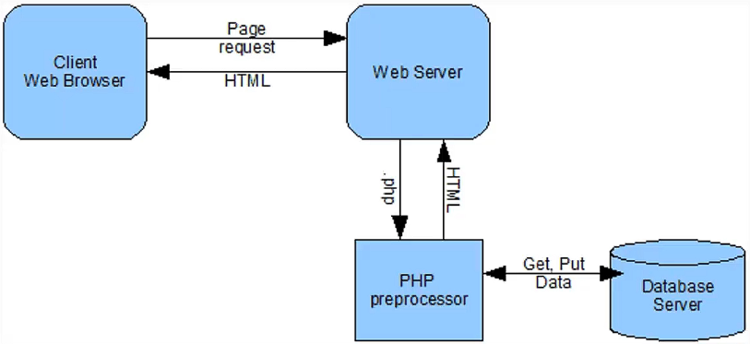
PHP/JSP/ASP
In the past, all of the front-end code (HTML, JS and CSS) was generated from the back-end.
User interactions with the webpage often required a full-page refresh.

Slide 10
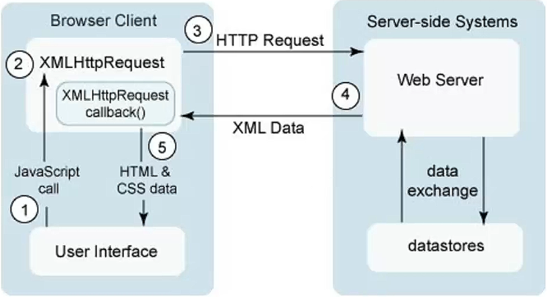
Ajax
Then came into play AJAX and JQuery.
The main idea was to load content asynchronously in the background to refresh portions of webpage.

Slide 11
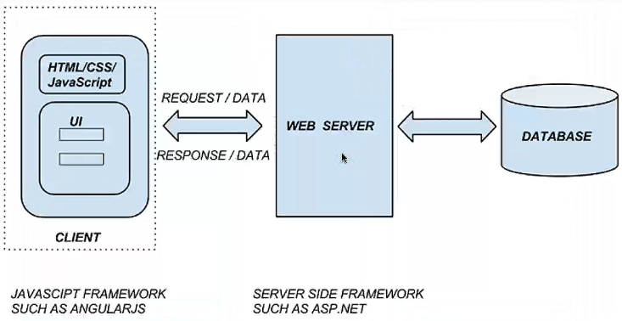
Angular
With Angular, the front-end code is now independent from the back-end.
The web server becomes a web-service that outputs JSON data, not dynamic HTML or CSS.

Slide 12
Different from AngularJS or React?
Why is Angular a revolution
What about AngularJS or 1.x
How is different from React

Slide 13
Angular is pretty much a Revolution
New languages: Typescript, ES6 and Dart
New tools: module managers, RxJS and transpiler
New template syntax
New concepts: components, pipes and so on
New tooling: Angular CLI – command line interface

Slide 14
What about AngularJS or 1.x ?
AngularJS or 1.x is still maintained as long as it is more popular than Angular or Angular 2+
AngularJS is now six years old, which is very old in today’s web dev world
Most of Angular new features are included in 1.x to facilitate migration from AngularJS to Angular

Slide 15
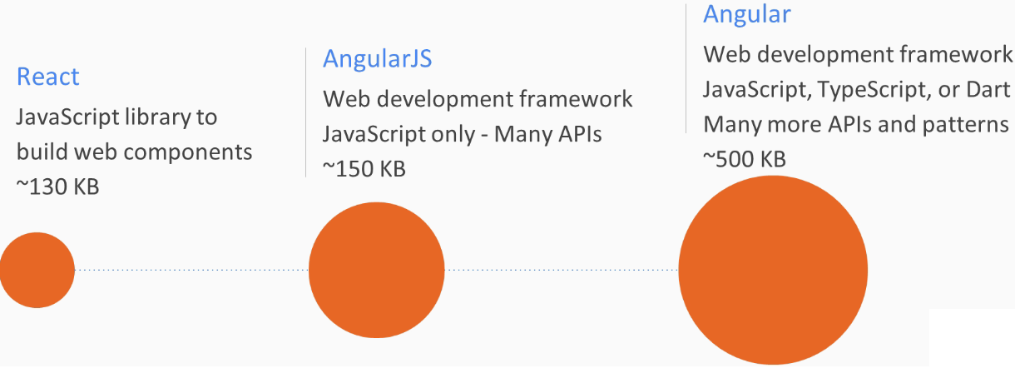
How is Different from React?

Slide 16
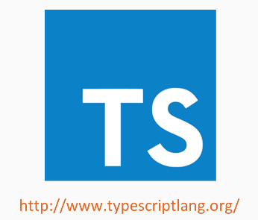
Why TypeScript and What is it?
What is TypeScript
Why use it
How is different from JavaScript

Slide 17
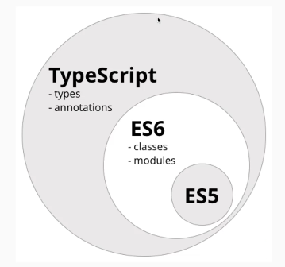
What is TypeScript?
TypeScript is strict superset of ES6 – tomorrow’ JavaScript Which is the next iteration of ES5 – today’s JavaScript
More familiar to back-end developers as it feels like Java, C# or .Net
Browser independent as Typescript compiles down to ESx anyway
As a result, you write your code once and it works everywhere
You’re free to use the features you want – and JavaScript is valid TypeScript

Slide 18
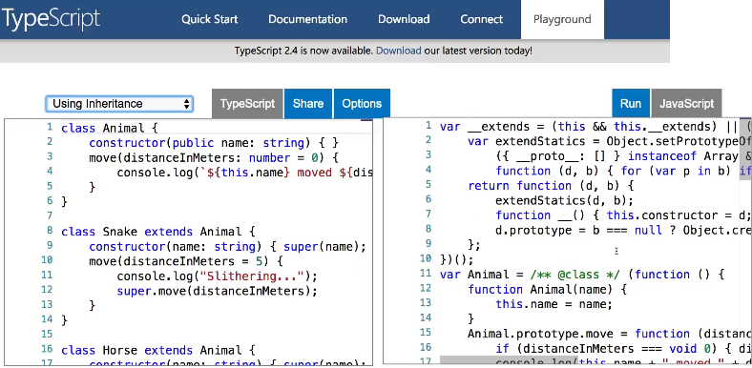
What is TypeScript?

Slide 19
Building Blocks of an Angular Application
Topics
All You Need to Know about Angular Modules
Introducing Components, Pipes, Directives, and Services
Bootstrapping an Angular Application
Using Angular CLI to Create Our Application

Slide 20
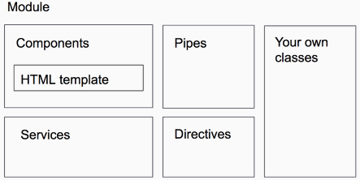
Know about Angular Modules
Angular Modules
What are modules
How modules configure an application
Lazy-loading code using modules

Slide 21
What are Modules?
A module is a package of TypeScript objects
Every Angular application has at least one module
The main module describes the structure of the application
It configures dependency injection as well as some specific module configuration
We can define modules for specific features that can be shared between different applications
Lazy-loading
A way to load modules on-demand, as they are needed

Slide 22
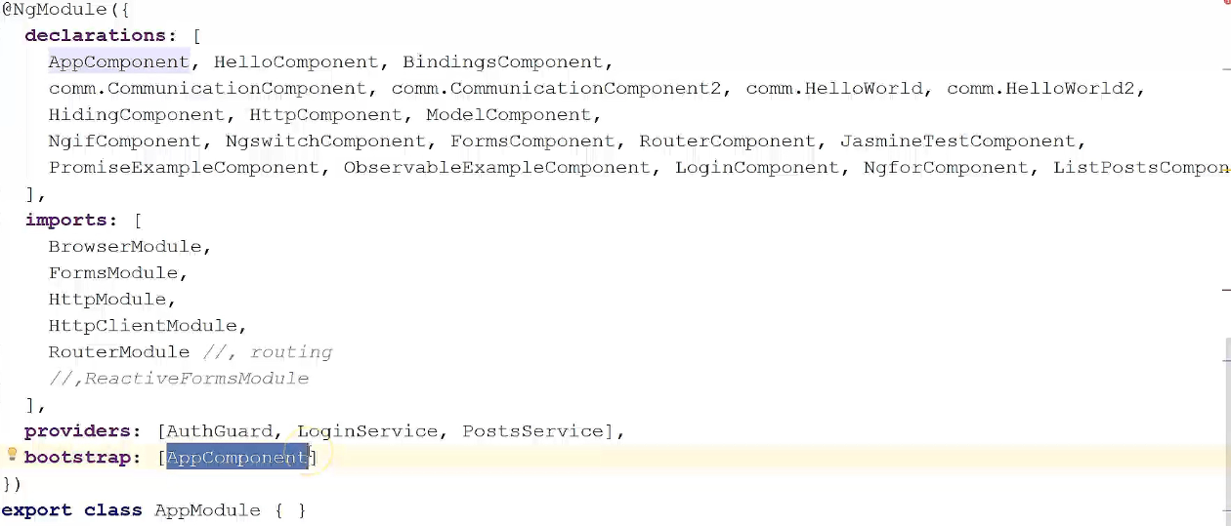
Typical App Module

Slide 23
Components, Pipes, Directives, & Services
What are Components
What are Pipes
What are Directives
What are Services

Slide 24
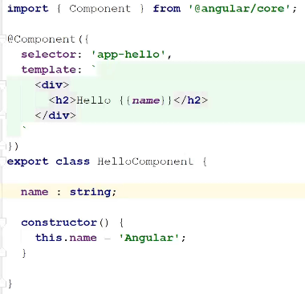
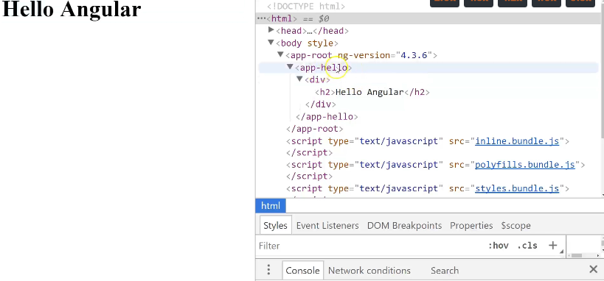
What are Components
A component is a reusable piece of HTML bundled with its TypeScript controller
Creating a component is like creating your own HTML element
80% + of the Angular code you are going to write will be components
An Angular app is tree of components

Slide 25
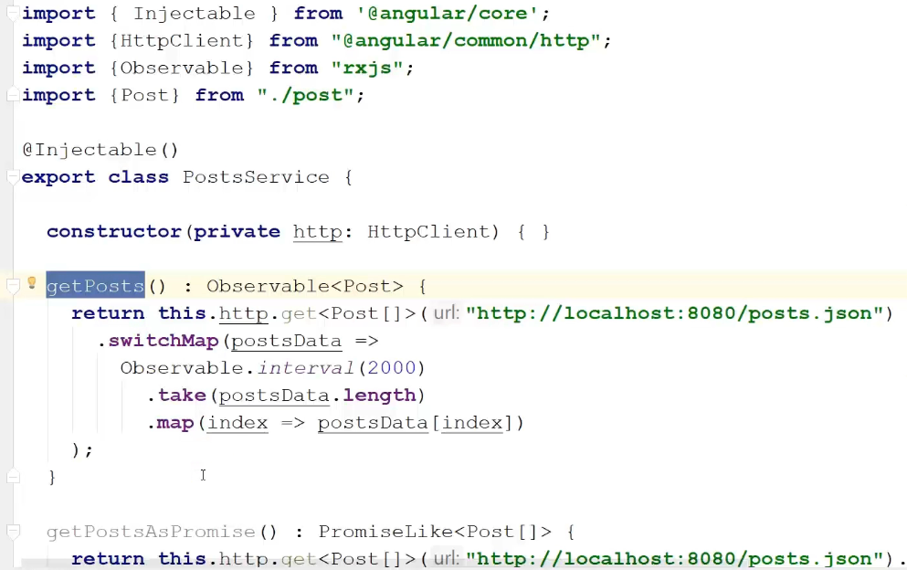
Services, Pipes and Directives
Services are used to handle the business logic of the app
Pipes are used to format data
Directives manipulate the DOM by creating elements, hiding them and so on
Components are specific directives that have a HTML template

Slide 26
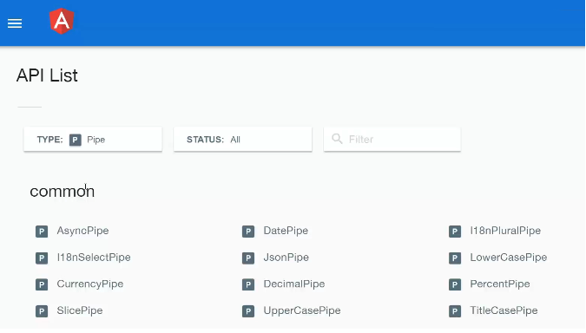
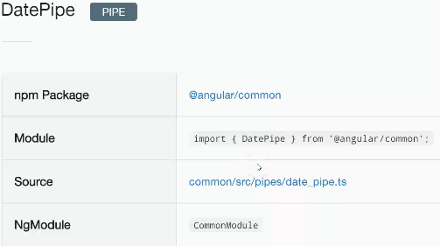

Slide 27
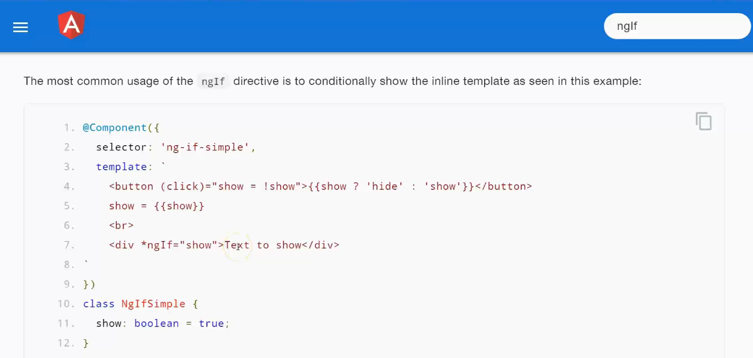
Typical Directives

Slide 28
Bootstrapping an Angular Application
Files involved in bootstrapping an Angular App
Role of index.html
Role of main.ts
Role of app.module.ts
The main module file app.module.ts defines the structure of the application
main.ts is the file use to bootstrap and application by specifying which module it should load and how it should be loaded
This allows Angular to know which HTML root element to look for in index.html to load the entire components tree

Slide 29
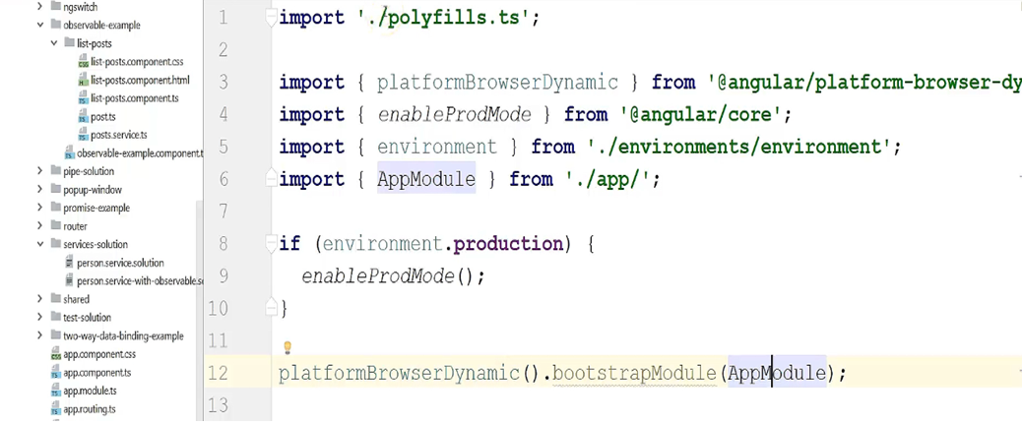
Typical main.ts

Slide 30
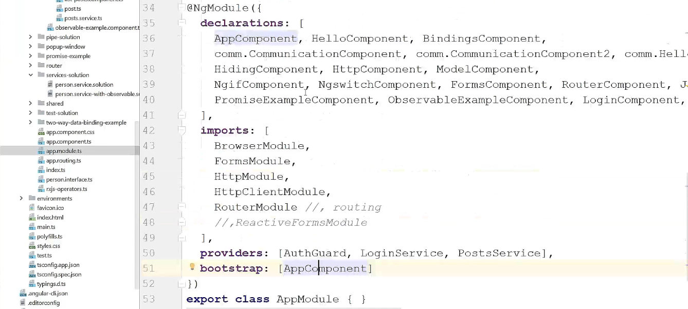
Typical app.module.ts

Slide 31
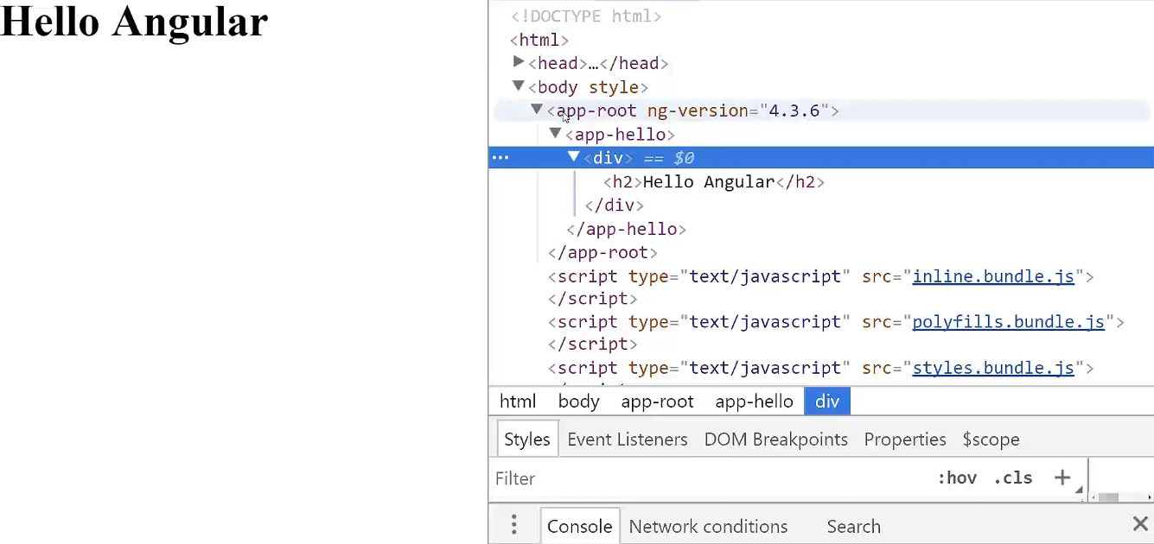

Slide 32
Using Angular CLI to Create Our Application
What is Angular CLI and how to use it
Creating projects and files with Angular CLI
Using CLI for development purposes
Using CLI to build our application

Slide 33
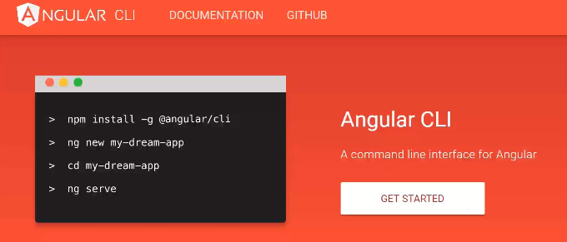
What is Angular CLI
Angular projects are complex, with many dependencies and a lot of set-up
As a result, the Angular team decided to provide a command line tool called Angular CLI to help – https://cli.angular.io/
CLI creates the entire structure of your project by following the best practices from the Angular team
It also allows you to generate new components, pipes and so forth from simple commands

Slide 34
Angular CLI
Check Version: ng –version
To update the CLI version or Reinstall npm uninstall -g angular-cli npm cache clean npm install -g angular-cli

Slide 35
Create a Start Project
1.Open a terminal window in VS Code.
2.Navigate to a suitable folder—for example, Documents.
3.Enter the following command, which will create a new Angular app in a folder called start and will create lots of files: ng new start-app
4.Navigate to the start folder.
cd start-app
5.Enter the following command to start the app:
ng serve
6.Open your web browser and browse to localhost:4200. You should see the text “welcome to app!”

Slide 36
What’s in the Root Folder?
File or Folder | What It Is
e2e | Folder for testing files (testing, Karma, and Protractor)
node_modules | Folder for project node dependencies
src | Folder for project source code
.editorConfig | Editor configuration file
.gitignore | Git ignore file
angular-cli.json | CLI configuration file. You change your CLI options in this file
karma-conf.json | Karma configuration file (testing, Karma, and Protractor)
package.json | Node dependencies configuration file
protractor-conf.js | Protractor configuration file (testing, Karma, and Protractor)
README.md | Readme informational file, contains information on CLI commands
tslint.json | Lint configuration file

Slide 37
What’s in the Source Folder?
File or Folder | What It Is
app | Folder for your application source code files, currently contains source code for an application component (more on this later)
assets | Folder for your application image and CSS files
environments | Folder for configuration files for environments—for example, configurations for development and production
favicon.ico | Application icon
index.html | The HTML page for the Angular single page application
main.ts | Code to start the application (more on this later)
styles.css | Global style definitions
test.ts | Code to run the application tests
tsconfig.json | Typescript/compiler configuration file

Slide 38
Modify the Start Project
1.Open a terminal window.
2.Navigate to the start-app folder and ensure that the ng server command is running.
3.Edit the file src/app/app.component.ts by changing it to the following:
title = 'app works! and has been modified....';

Slide 39
Compile Errors Runtime Errors

Slide 40
File Watcher and Web Server
ng serve running, this watches our files (performing a compile and redeploy when necessary) and runs a local web server on localhost:4200. When you change something and click Save, the watcher does the following:
Creates a Webpack build, including transpilation to compatible JavaScript and bundling code (more on Webpack later in this book)
Generates a new index.html file, adding script references as required to reference the JavaScript files bundled by Webpack
Performs a new deployment onto the local web server
Refreshes the web page

Slide 41
Bootstrapping
Bootstrapping usually refers to a self-starting process that’s supposed to proceed without external input. In this case, it refers to how an Angular application starts up.
1.The web browser opens the file index.html by default.
2.The browser loads the script files on the end. This includes main.bundle.js, which is a transpiled version of the typescript file main.ts. This is our main app entry point.
3.Main.bundle.js loads some modules then calls the following Angular system code:
platformBrowserSpecific().bootstrapModule(AppModule)

Slide 42
Bootstrapping
4.AppModule is loaded—it’s the root Angular module used to bootstrap the application. This is an Angular module, not a JavaScript module they’re different things. If you look at AppModule.ts you’ll see that it contains the following line to tell the module to bootstrap with the AppComponent::
@NgModule({
...
bootstrap: [AppComponent]
})
5.The AppModule bootstraps with the AppComponent , injecting the component into the space between the start and end tags app-root:
<app-root>Loading...</app-root>

Slide 43
Useful CLI Options
--flat :Generates a cli project with a flat file structure, not generating each component in its own directory.
--inline-template :Generates components with inline templates. Component template markup will be generated within the component rather than in a separate file.
--inline-style: Generates components with inline styles (more on those later). Component styles will be generated within the component rather than in a separate file.
--spec false: Generates component without the unit testing ‘spec’ files that are normally generated for you by default.
--minimal :Generates a minimal cli project with inline templates, styles and without tests.

Slide 44
The package.json File
Node is designed to be run from the command line within a project folder. It allows developers to store information pertinent to their project in a package.json file, which should reside in the root folder of your project. This file specifies many useful things about your project:
The name and version of your project.
What Node modules your project depends on (and what versions of these modules you need).
What Node modules are required for your project in production.
What Node modules are required for your project in development (that is, not needed for production).

Slide 45
Updating package.json
By using node commands (on the command line) that install/update/delete Node modules and update this file.
By editing this file yourself. Then you run Node commands to install/update/delete Node modules to match this file.
To install the dependencies outlined in the package.json file, enter the following on the command line in the root folder of your project:
npm install

Slide 46
The Folder node_modules
When you install a Node module , it’s downloaded and placed into the subfolder node_modules within your project folder.
Sometimes it takes a long time for npm to download and install the project Node modules.
There are two different ways of installing modules into Node. You can run the command npm install specifying the module (to install it) or you can edit the package.json file and then run npm install.

Slide 47
Installing The Latest Angular
npm install -g @angular/cli
ng new my-dream-app
cd my-dream-app
ng serve

Slide 48
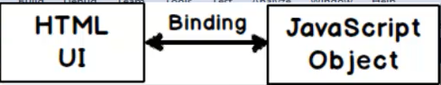
Data Bindings

Slide 49
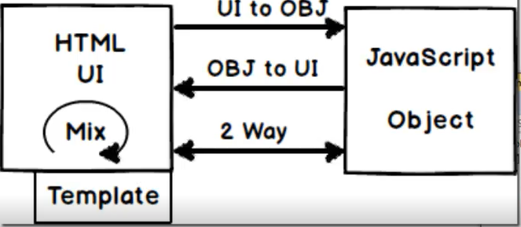
Data Bindings
One Way
UI to Object ()
Object to UI []
Two way[()]
Interpolation {{}}
Template

Slide 50
Angular Components, Directives and Pipes
Topics
What are components
Templates and Expressions
Different Types of Data Bindings
Most Important Angular Directives
Most Important Angular Pipes

Slide 51
Angular Components
What are components
Example of Angular components
Let’s create a component and use it

Slide 52
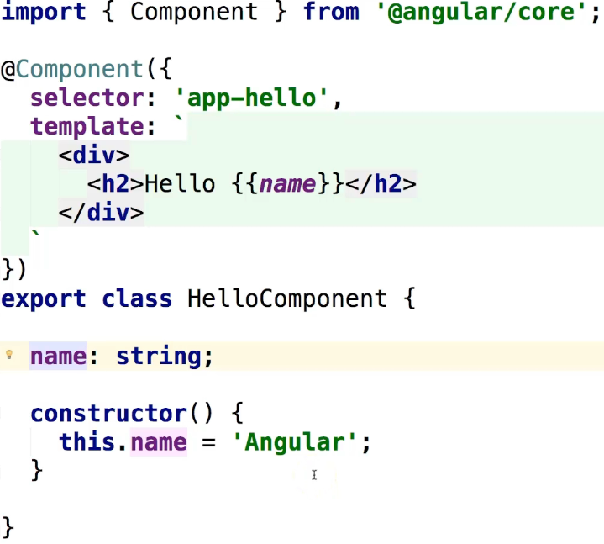
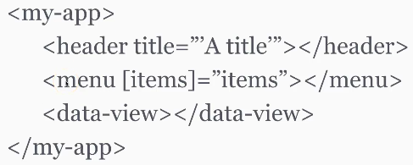
What are components
Components are HTML elements that we create.
An Angular application is a tree of components.

Slide 53
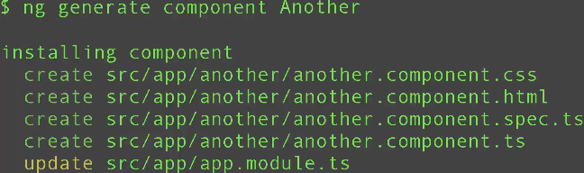

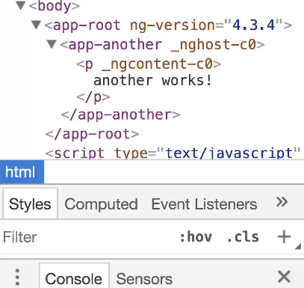
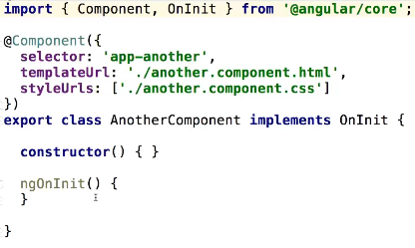
To create a component

Slide 54
Templates and Expressions
What expression can do
How to customize HTML templates
CSS scoping in components

Slide 55
Templates and Expressions
What expression can do {{syntax}}
Expressions binds data from your model to your HTML template
When the data changes, the HTML gets automatically refreshed
Expressions run in the context of your component
Any method or property of your component class can be used in an expression
Expressions can use regular JavaScript features like appending text or defining conditions using the ternary operator – condition ? Then : else

Slide 56
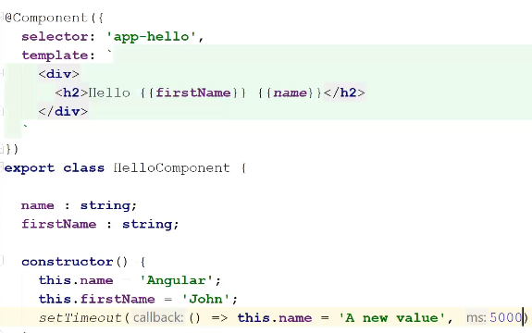


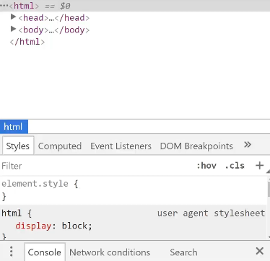
Typical Expressions

Slide 57

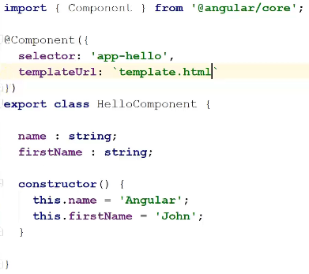
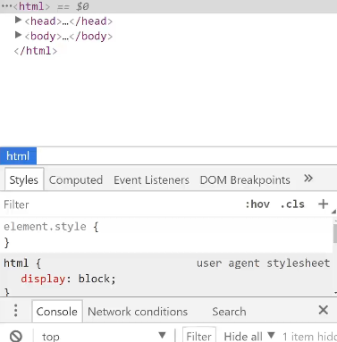
Typical HTML Templates

Slide 58
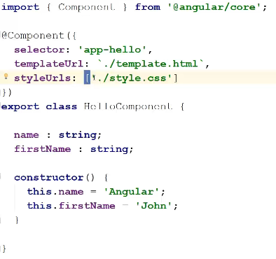

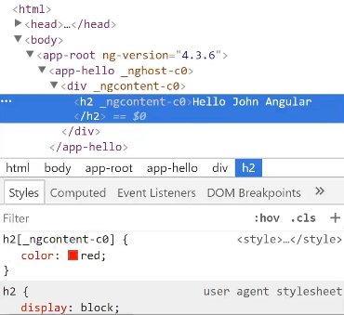
Typical CSS Templates

Slide 59
Templates and Expression
Templates and Expression make our HTML code dynamic
Expressions are JavaScript that runs on every time our data model gets updated.
Templates use expressions to make the HTML dynamic.
Both HTML and CSS are scoped at the component level.

Slide 60
Different Types of Data Bindings
One-way data bindings with [] and {{ }}
One-way data bindings with ()
Two-way data bindings with [(ngModel)]
Expressions {{ }} and bindings with [] are one-way data bindings
Event bindings with () are one-way data bindings
[(ngModel)] works both ways

Slide 61
One-way data-bindings
One-way data-bindings with [] and {{ }}
Square brackets [] can be used to bind a component property to an HTML property
For instance:
Expressions with {{ }} work the same way
The Main difference is that expressions can be used everywhere, not only on HTML properties:
Parentheses () can be used to register an event listener
For instance:
Parentheses define a data-binding from the HTML to your component
Square brackets and expressions define a data-binding from your component to the HTML
That’s why all of them are one-way data bindings

Slide 62
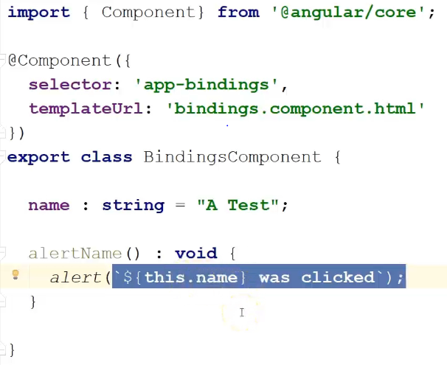

Slide 63
Most Important Angular Directives
What are directives
*ngFor and *nglf
*ngSwitch
*ngClass

Slide 64
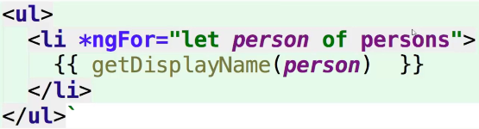
ngFor Directive
*ngFor Directive
ngFor is a structural directive
Equivalent of AngularJS ng-repeat
A loop to iterate through data model items:

Slide 65
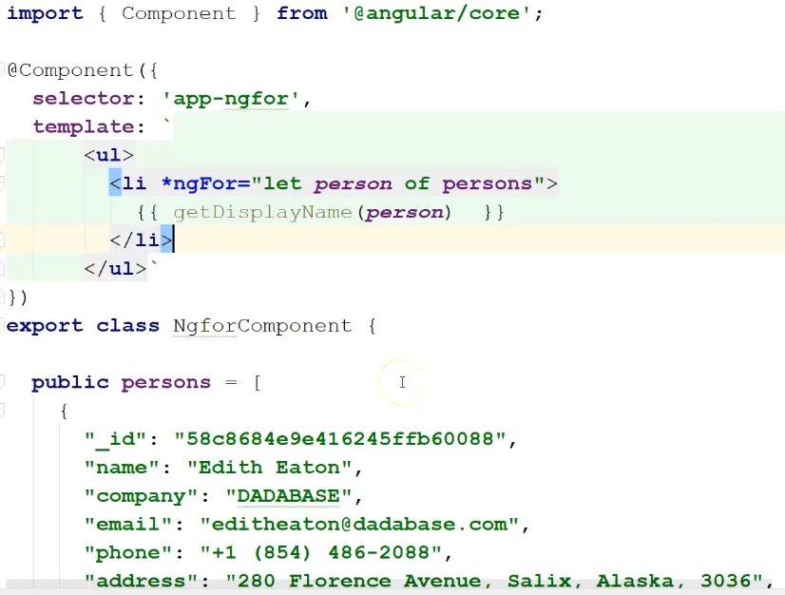
Typical ngFor directive

Slide 66
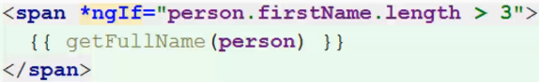
nglf Directive
nglf Directive
nglf is structural directive
Equivalent of AngularJS ng-if
A way to display an HTML element based on a condition:

Slide 67
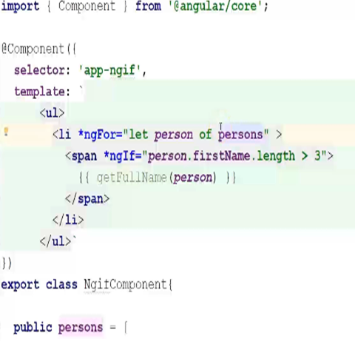
Typical nglf directive

Slide 68
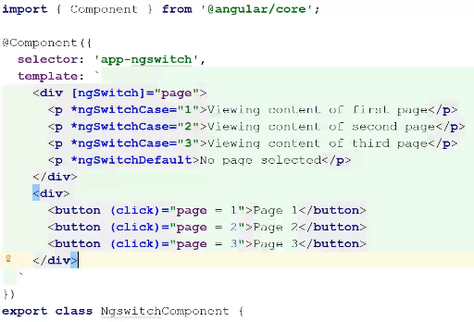

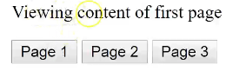
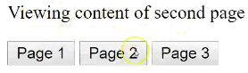
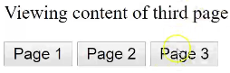
ngSwitch directive
ngSwitch directive
Switch-case implementation for Angular
Allows to display content conditionally:

Slide 69
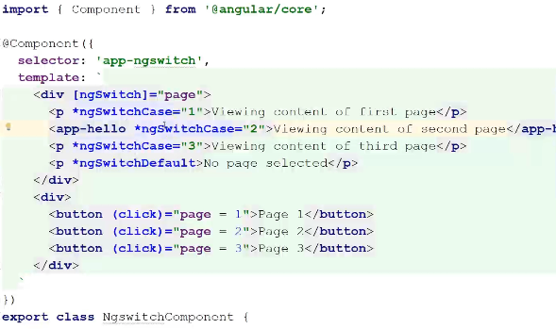
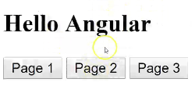

Slide 70
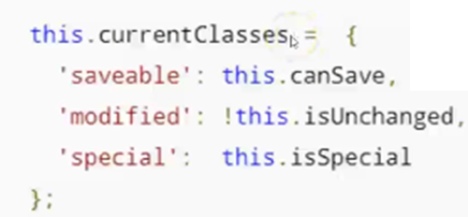
ngClass Directive
ngClass Directive
While we can bind expressions to both style and class HTML attributes, ngClass allows us to apply multiple styles conditionally:
CurrentClasses in an object defined as follows in our TypeScript code:

Slide 71
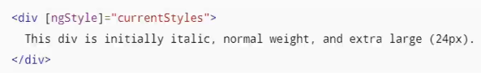
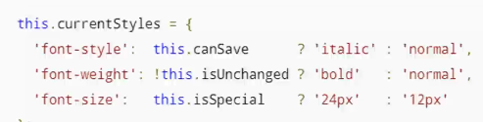
ngStyle Directive
ngStyle Directive
ngStyle is similar to ngClass
It allows us to tweak several style properties conditionally
CurrentClasses is an object defined as follows in our TypeScript code:

Slide 72
Directives
Directives are a way to manipulate the DOM to make it dynamic
*nglf can remove HTML elements conditionally
*ngfor can repeat elements ngSwitch is similar to *nglf with multiple conditions

Slide 73
Most Important Angular Pipes
What are pipes
String pipes
Number pipes
Data pipe
How to create our own pipes
What are pipes
Pipes are used to format data for display
Equivalent of AngularJS filtes
Pipes can be chained
We can write our own pipes

Slide 74
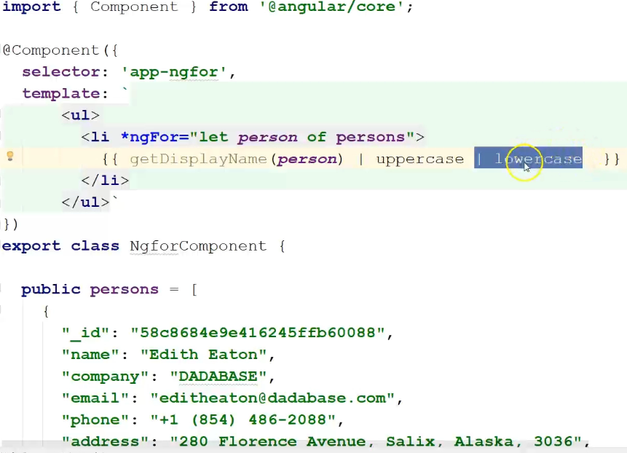
String pipes
String pipes
Uppercase, lowercase and titlecase are pipes used to format strings
There are also pipes for internationalization (i18n)
Here is an example of how to use uppercase:

Slide 75
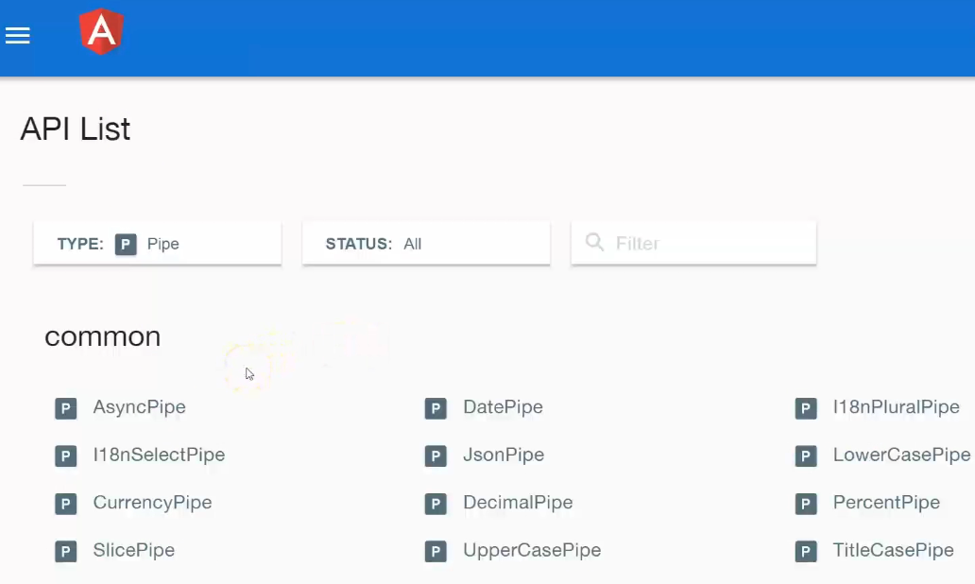

Slide 76
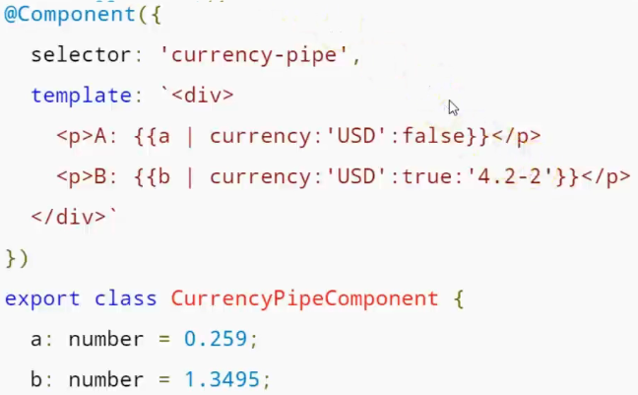
Number Pipes
Number Pipes
Number, percent and currency are pipes use to format numbers
These pipes take parameters to be customized

Slide 77

Date pipe
Date pipe
Allows to format dates with some predefined or custom formats:

Slide 78


Slide 79

Date Pipe
Date Pipe
Angular CLI is here to help:
ng generate pipe myCustomPipe
CLI generates the default structure for the pipe
All we have to do is implement the transforms() method:

Slide 80
Forms
Angular 4 has a new Forms module that makes it easier to do the following:
Create forms dynamically
Validate input with common validators (required)
Validate input with custom validators

Slide 81
Form Model Objects
Below supports both ways of writing forms:
FormGroup
FormControl

Slide 82
NgForm
Stores state information for the form, including the following:
Values for all the controls inside the form
Groups of fields in the form
Fields in the form
Validators

Slide 83
Form Group
Stores the value and validity state of a group of FormControl instances:
Values for all the controls inside the form group

Slide 84
Form Control
Stores the value and validity state of an individual control—for instance a listbox:
Value
Validation state
Status (for example, disabled)

Slide 85
Forms and CSS
Supports both methods of writing forms: template and Reactive. When you have form validation, you need to highlight invalid data when it occurs.
Style | Description
ng-touched | Style applied if control has lost focus
ng-untouched | Style applied if control hasn’t lost focus yet
ng-valid | Style applied if control passes validation
ng-invalid | Style applied if control doesn’t pass validation
ng-dirty | Style applied if user has already interacted with the control
ng-pristine | Style applied if user hasn’t interacted with the control yet

Slide 86
Services, Dependency Injection & working with Server Data
Topics
Component Communication in Angular
What are Services?
Understanding Dependency Injection in Angular
Using the HttpClient to Interact with the Server

Slide 87
Why would components communicate
Why would components communicate
To share some data – username, session and so on
To react to events triggered by other components when user clicks here, do something elsewhere
To avoid retrieving the same data from the server over and over again

Slide 88

Using @Input and @Output
Using @Input and @Output
An Angular app is a tree of components that can interact with one another
@Input() and @Output() are decorators made to achieve that
@Input() is a way to pass data to a component
@Output() is a way to emit data from a component through events

Slide 89


Slide 90


Slide 91
Components
Components can use services or specific decorates to communicate and to share data
Services are the best option:
Very flexible and loosely coupled.
@Input and @Output can be used to have two-way communication between parent/child are siblings.
@ViewChild can inject a reference to a child component.

Slide 92

Using services for component communication
Using services for component communication
One way to achieve data-sharing between components is to use services
Services are singletons so these two components would access the same data once loaded

Slide 93
What are Services
What are Services
The @Injectable decorator
The providers array
Role of constructors in dependency injection

Slide 94
What are Services
Services are meant to handle application logic – fetch data, update data and so on
They are used to interact with servers
Unlike components, they don’t have a HTML template
They are classes that can be injected

Slide 95
Create Services using CLI
CLI Supports to create services using below command:
ng generate service my-new-service
Note: there will be a warning while creating a service that the service needs to be added in the Provider’s Array of the module.

Slide 96

The @Injectable Decorator
The @Injectable Decorator
The @Injectable decorator turns a class into an injectable services.

Slide 97

The Providers Array
The Providers Array
Any class marked as injectable is candidate for dependency injection
In order for dependency injection to be possible, that class has to be added to the providers array of any injector:

Slide 98

Role of constructors in dependency injection
Role of constructors in dependency injection
Constructors are how a component, service, directive or pipe request for a specific service to be injected:

Slide 99
Services
Services are classes that can be injected in any other Angular object
Business logic is meant to be handled in services
Any class decorated with @injectable is a service
The array of providers lists classes that can be injected

Slide 100
What is dependency injection
What is dependency injection
It`s a technique where an object supplies the dependencies of another object
Dependency injection is one form of inversion of control
Main goal – decouple objects from their dependencies so that dependencies can easily get swapped at runtime
Useful for testing, mocking and stubbing

Slide 101
Routers
In most web applications, users navigate from one page to the next as they perform application tasks. Users can navigate in these ways:
Entering a URL in the address bar
Following links, clicking buttons, and so on
Going backward or forward in the browser history
The router can interpret a browser URL as an instruction to navigate to a component and pass optional parameters (which contain information) to the component to give it contextual information and help it decide which specific content to present or what it needs to do.

Slide 102
Routers
Object | Type | Description
RouterModule | Module | A separate Angular module that provides the necessary service providers and directives for navigating through application views.
Router |  | Displays the application component for the active URL. Manages navigation from one component to the next.
RouterOutlet | Directive | The directive (<router-outlet>) that marks where the router displays a view.
RouterLink | Directive | The directive for binding a clickable HTML element to a route. Clicking an element with a RouterLink directive that’s bound to a string or a link parameters array triggers a navigation.

Slide 103
Routers
Object | Type | Description
ActivatedRoute |  | A service that’s provided to each route component that contains route-specific information such as route parameters, static data, resolve data, global query params, and the global fragment.
RouterState |  | The current state of the router including a tree of the currently activated routes together with convenience methods for traversing the route tree.

Slide 104

Configuring the Component Router
It requires a routing table which maps a URL to a component (app.routing.ts)

Slide 105

Defining a router-outlet
<router-outlet> is the place where routed components are loaded in the HTML template

Slide 106


Parameters
Parameters have to be named in the router config:
Then parameters can be retrieved by injecting the ActivatedRoute service and subscribing to its paramMap:

Slide 107
The component router can load components based on URL
We have to define a routing table
<router-outlet> indicates where routed component get loaded in the HTML
Routes can have parameters and we can subscribe to parameter updates

Slide 108
Template Driven Forms in Angular
Overview of forms in Angular
Template driven forms
Properties added by Angular to help with validation
Example of field validation in a form

Slide 109
Overview of Forms in Angular
Overview of Forms in Angular
Angular provides tools to automate form management:
Data bindings
Form submission
Form validation
Error handling
There are two different ways to handle forms:
Template-driven
Model-driven or Event-driven or Reactive Forms

Slide 110
Reactive Forms in Angular
The FormBuilder object to create a reactive form
How to use form validation properties in our template
Example of field validation in a reactive form
Writing our own custom validation function

Slide 111

The FormBuilder object
The FormBuilder object to create a reactive form
The set-up of the form happens in TypeScript instead of in HTML template, using a FormBuilder object:

Slide 112

How to use form validation properties in our template
We bind the formGroup property to our registerForm property, which returns the form into a reactive form:
Then we can access every element by name from the controls property as follow: registerForm.controls.firstname

Slide 113


Example of Reactive Form

Slide 114


Example of Custom Validator

Slide 115
www.cognixia.com

